Slide 1





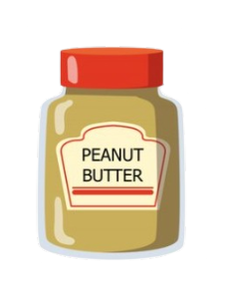

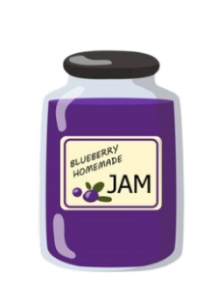




AVISHKAR
Team PureTech

Slide 2





Problem Statement
Your paraIn today's online shopping landscape, consumers face a significant challenge in understanding the composition and safety implications of the products they purchase. The lack of detailed ingredient information leaves users unaware of potential health risks associated with the items they buy. Existing platforms fail to offer comprehensive insights into ingredient safety, leaving consumers vulnerable to making uninformed decisions. Thus, there exists a pressing need for a sophisticated solution that can analyze product ingredients, evaluate their safety profiles, and provide users with actionable information to make informed purchasing decisions.graph text

Slide 3




TECH STACK JOURNEY
Google AI
Python
Streamlit
Web scraping tool- Beautiful Soup

Slide 4
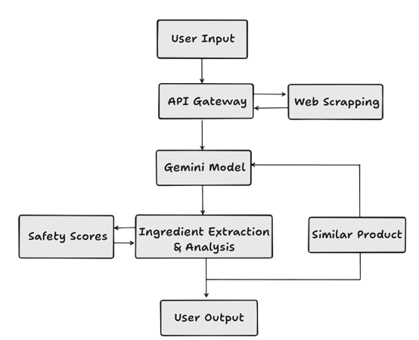
SOLUTION ARCHITECTURE

Slide 5



OUR SOLUTION
Product Overview
1
The proposed solution involves developing a sophisticated AI model for product safety analysis.
Utilize machine learning algorithms to process user-inputted product links.
Provide accurate safety assessments based on a comprehensive dataset.
2
Detailed breakdown of ingredients
3
Harmful Ingredients and Side Effects
4
Aggregated user reviews
5
Suggestions for safer Alternatives

Slide 6











About Us
Sumith Sigtia
1OX21AI039
Vidhan Mehta
Swathi S
Venkatraju
1OX21AI046
1OX21AI047
1OX21AI041

Slide 7
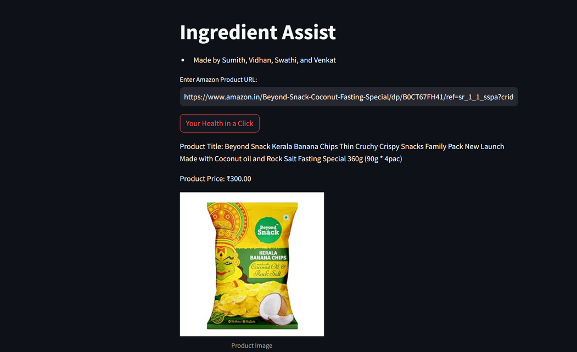
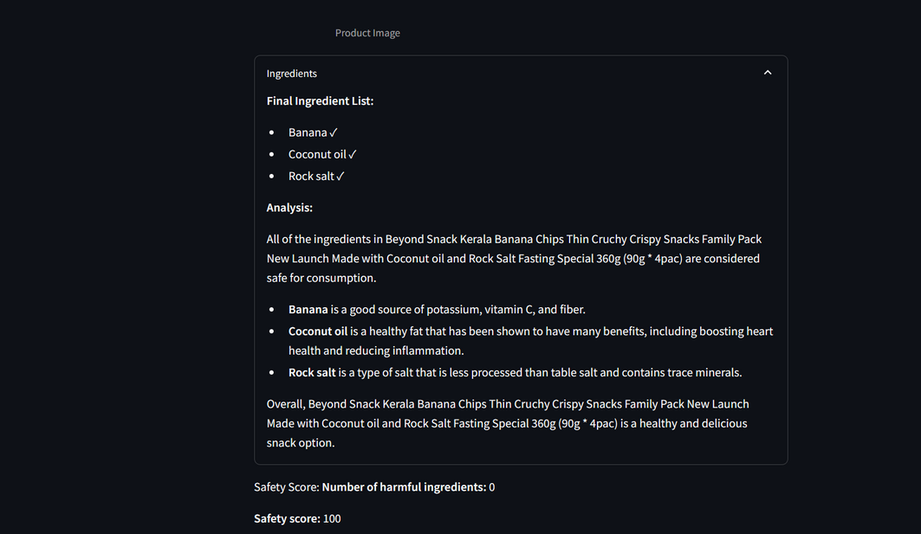
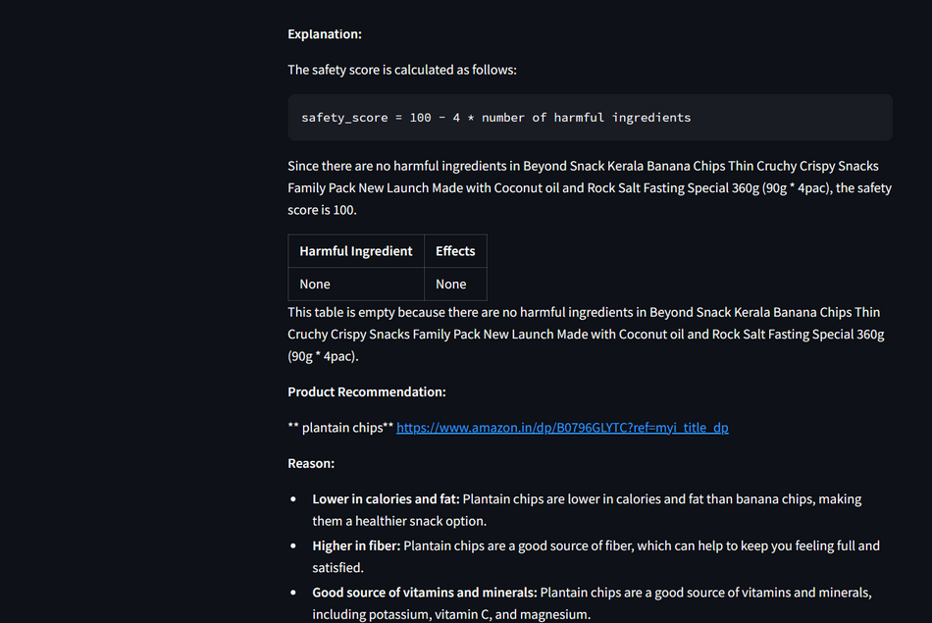




SCREENSHOTS OF THE APPLICATION

